Slide 1

A fully web3 native credit score

Slide 2

Contents
The Problem
The Solution: Sanka Score
Scoring Mechanics
Optimistic Attestation
Use Cases
Why Canto?
Team
Next Steps

Slide 3

Problem
Limited Capital Efficiency due to Lack of DeFi Risk Assessment
Elevated Borrowing Costs for Extending Credit on Chain
Limitations of Web3 Credit Bureaus Resolution Attempts

Slide 4
Issues with Current Resolution Attempts
Transparency
Models hosted on off-chain web2 infrastructure, kept as proprietary IP
Explainability
Complex Machine Learning models difficult to explain & hard to understand
Reliability
Data Pipelines dependent on privately hosted infrastructure

Slide 5
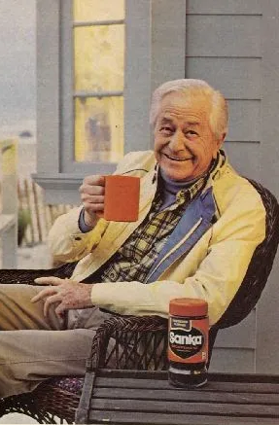
Solution – Introducing Sanka!
Sanka Score:
Web3 Native Public Good
Fully Transparent
Easy to Interpret
No Web2 Dependencies
Community Driven
Generally Free of Bullshit

Slide 6

How does the Sanka Score, Score?
Principles of Bayesian Inference
Use of Canto’s Liquidity Market (CLM) improves/worsens score over time
Beta Distribution used to model Bernoulli Random Variables (0-1 outcome)
From distribution, expected value of the probability of default / liquidation
From probability, translation to Sanka Score

Slide 7
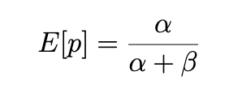
Deep Dive 1/2: Beta Distribution
“𝞪” represents ‘good’
“𝞫” represents ‘bad’
As 𝞪 increases relative to 𝞫 , the credit quality of the borrower improves.
Increment function (discussed more in whitepaper) determines how to migrate credit behavior based on observable on-chain events

Slide 8
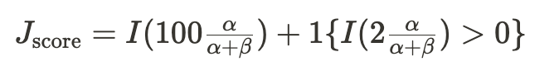
Deep Dive 2/2: Score Derivation
Probability of default/liquidation translated into Sanka Score
0 = 0% chance of being a good borrower
100 = 100% chance of being a good borrower

Slide 9
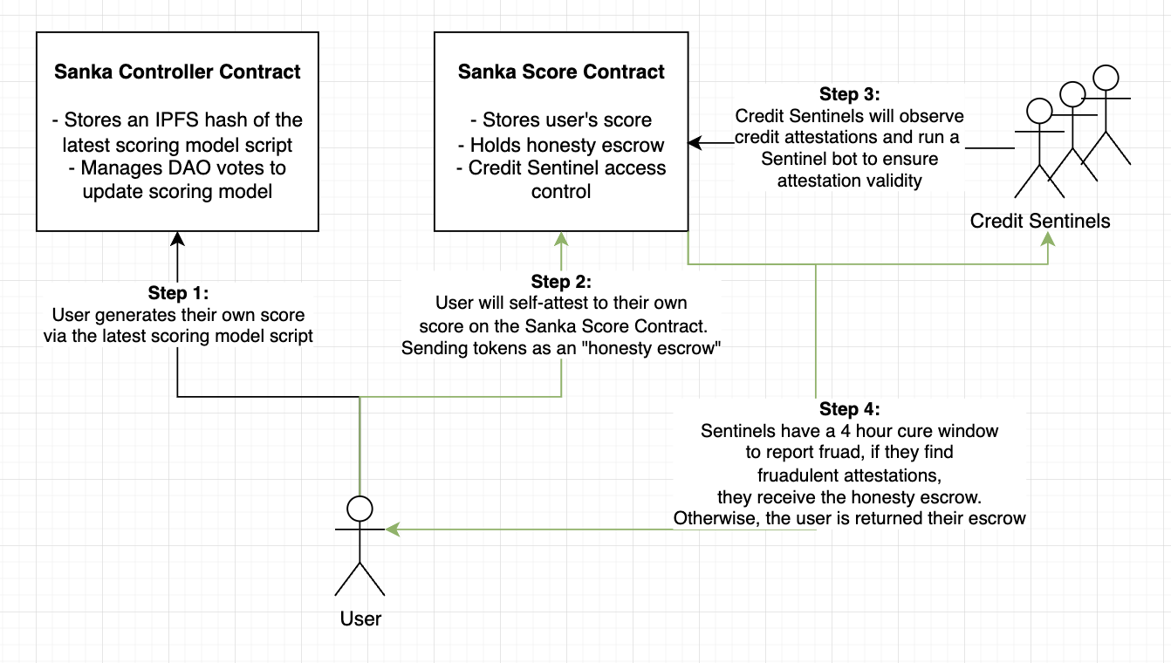
Optimistic Attestation

Slide 10
Use Cases 1/3
Lending
Interest rate adjustments & required maintenance LTV’s based on creditworthiness

Slide 11
Use Cases 2/3
Trust
Reliability in doing the things you say you’ll do, like repaying a loan, is a proxy for trustworthiness.
People could collateralize agreements as loans, which would liquidate if that trust was broken, harming their score. Or alternatively, improve score if agreement was met.
This is effectively a trust escrow.

Slide 12
Use Cases 3/3
Reputation
Stake credit when making hard to prove claims
Loan liquidation as a consequence of lying. Thus holding public figures to account.
This is effectively a reputation escrow

Slide 13
Why Canto?
Values Alignment
FPI
Efficiency of Collateralized Liquidity
Nod To Public Goods
Ecosystem > Extraction
Users > Profits

Slide 14



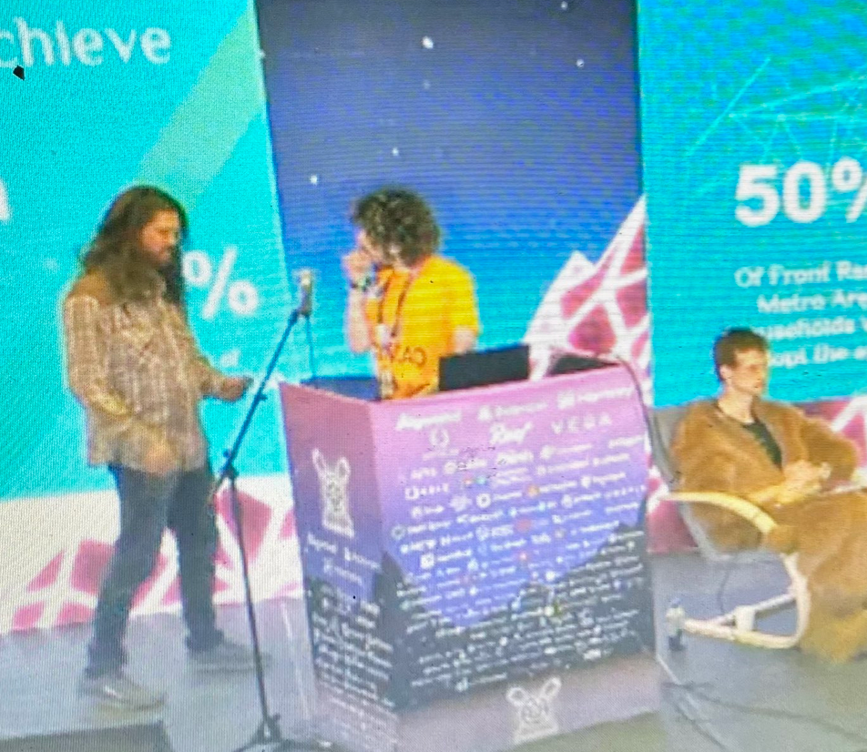
Team
Saki Brew Chemist
Colin Nielsen Artisan Barista
Daniel Ritchie Bean Procurement

Slide 15
Next Steps for Sanka
Solicit Feedback
Make Go/No-Go Decision
Further Explore Canto Ecosystem
Lift Stealth Mode
BUIDL

